Slide 1
Interpretable Recurrent Neural Networks for Carbohydrate Substrate Prediction
Ved Piyush, Yin Lab

Slide 2
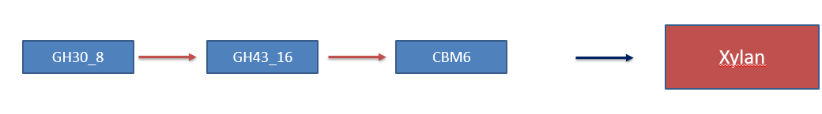
Terminologies
CAZymes: Carbohydrate Active Enzymes
Enzymes that synthesize and modify all carbohydrates on Earth.
Carbohydrates: Sugar molecules that provide the body with glucose.
Glucose: Provide the human body energy for functioning.
CAZymes Gene Clusters (CGCs)
Cluster of CAZymes.
CAZymes work alongside each other to operate on carbohydrates.
Xylans are carbohydrates found in foods such as wheat, rice, corn, etc.

Slide 3
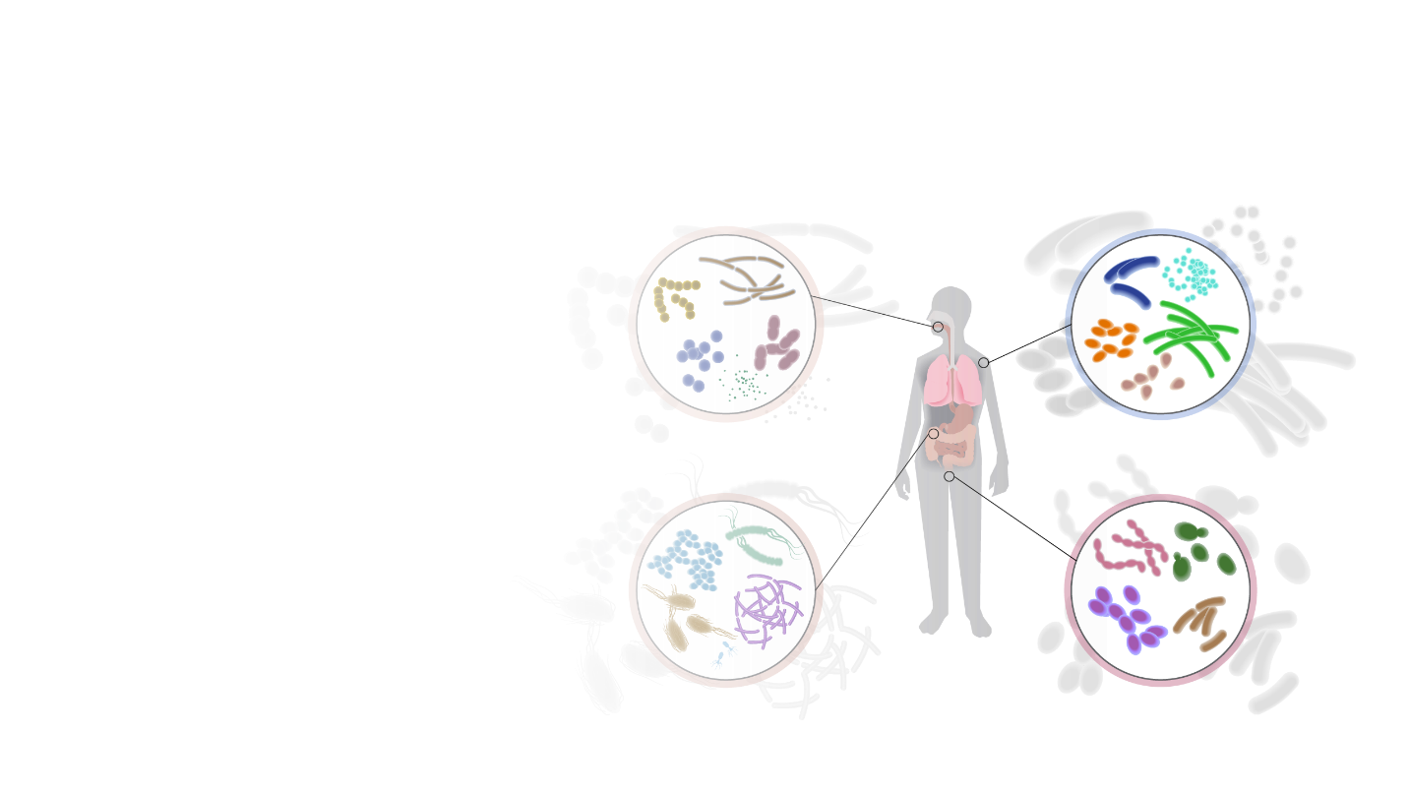

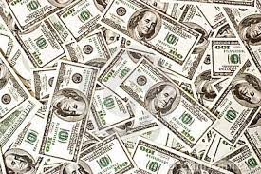

Why study CGCs?
Personalized Nutrition:
Based on the naturally occurring bacteria (microbes)
What kind of food we should take in our diet?
Diabetes, Obesity, and Cardiovascular Diseases - Lifestyle-related
Can be addressed using interventions via personalized nutrition.
Roughly $10 billion dollar industry
Fast growing – Estimated to be worth $17 Billion dollars in 2025
Personalized Nutrition company based out of Nebraska Innovation Campus.
Have already raised three seed rounds totaling $6.4 million dollars.

Slide 4
Agenda
The two key goals.
Data
Supervised Data
Unsupervised Data
Recurrent Neural Networks
Without Attention Module
With Attention Module
Result
Substrate Prediction
Signature Genes

Slide 5
Two key goals
Xylan
GH30_8
GH43_16
CBM6
GT4
9.B.18
GT4
2.A.66
Capsule Polysaccharides
Goal 1: Predict the Carbohydrate substrate that a given CGC can synthesize.
Goal 2: Tell which CAZymes are most influential for this substrate prediction.

Slide 6
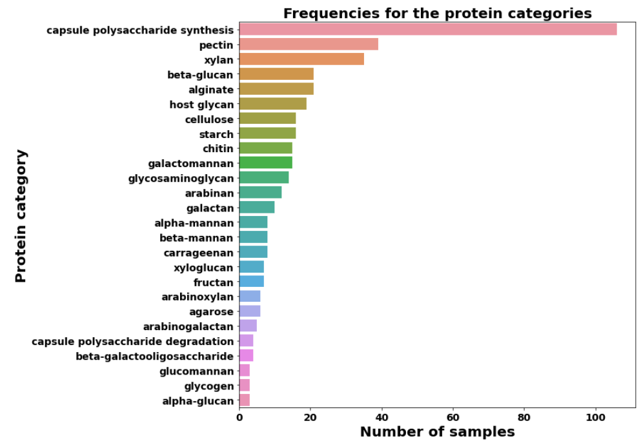
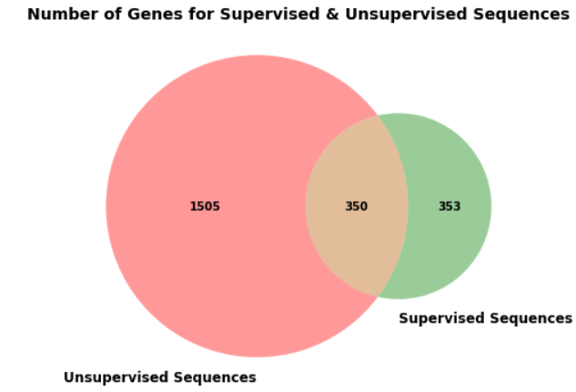
Data
Supervised dataset
411 CGCs belonging to 26 different substrate categories.
353 unique genes.
Unsupervised dataset
Close to a quarter million CGCs.
1505 unique genes.

Slide 7
Word2Vec to CAZy2Vec
Word2Vec
CAZy2Vec
Technique from the field of Natural Language Processing.
Learns a vectored representation for words from a corpus of text.
Semantically similar words are closer in the learned vector space.
For any observed gene in the supervised + unsupervised corpus:
Can provide a feature vector of d dimension.
Give a similarity score for any pair of genes.
Can even give a feature vector for an unobserved gene token. (FastText)

Slide 8
Deep Learning Models – Recurrent Neural Networks

Slide 9
Recurrent Neural Networks (RNNs)
Assumption
Data has a sequential order to it.
We know that there is a sequential nature to the CGCs.
RNNs are feature extractors that process the genes in sequential order.
Gene | Dimension 1 | Dimension 2 | Dimension 3 | Dimension 4
Cazy2Vec(GH30_8) | -0.04 | 0.06 | 1.73 | -2.34
Cazy2Vec(GH43_16) | 4.11 | -2.22 | 1.61 | 3.41
Cazy2Vec(CBM6) | -1.27 | 2.45 | 8.97 | -0.96
Steps
Read Cazy2Vec(GH30_8) – keep a hidden memory till the first gene position, say Hidden(GH30_8)
Read Cazy2Vec(GH43_16) – keep a hidden memory till the second gene position, say Hidden(GH43_16, GH30_8)
Read Cazy2Vec(CBM6) – keep a hidden memory till the third gene position, say Hidden(CBM6, GH43_16, GH30_8)
Use Hidden(CBM6, GH43_16, GH30_8) as the feature to be used in a prediction model.

Slide 10
Combing CAZy2vec vectors – inattentive model
Gene | Dimension 1 | Dimension 2 | Dimension 3 | Dimension 4
Hidden(GH30_8) | -1.24 | 4.56 | 0.05 | 3.72
Hidden(GH43_16) | 9.43 | 2.67 | 3.42 | 2.34
Hidden(CBM6) | -3.36 | 8.32 | 5.67 | -0.74
Central question – How do we combine these three vectors to produce a 1-dimensional vector?
Uniform weights solution
Assign uniform weights:
Hidden(GH30_8) = Hidden(GH43_16) = Hidden(CBM6) = 1/3
Element-wise weighted average
(1/3) Hidden(GH30_8) + (1/3) Hidden(GH43_16) + (1/3) Hidden(CBM6)
No learning is required to compute these weights.

Slide 11
Methods – Averaging gene vectors using Attention Module

Slide 12
Combing CAZy2vec vectors – attentive model
Gene | Dimension 1 | Dimension 2 | Dimension 3 | Dimension 4
Hidden(GH30_8) | -1.24 | 4.56 | 0.05 | 3.72
Hidden(GH43_16) | 9.43 | 2.67 | 3.42 | 2.34
Hidden(CBM6) | -3.36 | 8.32 | 5.67 | -0.74
Learnable weights solution
Design a network that can learn customized weights for each gene in the sequence.
Great for interpretability – can now tell the users which genes contributed most to the classification into a specific category.
Weights sum up to 1
Model can learn for instance GH30_8 is very important and can communicate this to us via the weight parameter.
weight(GH30_8) =0.8
Element wise weighted average – (0.8) Hidden(GH30_8) + (0.1) Hidden(GH43_16) + (0.1) Hidden(CBM6)

Slide 13
Results

Slide 14
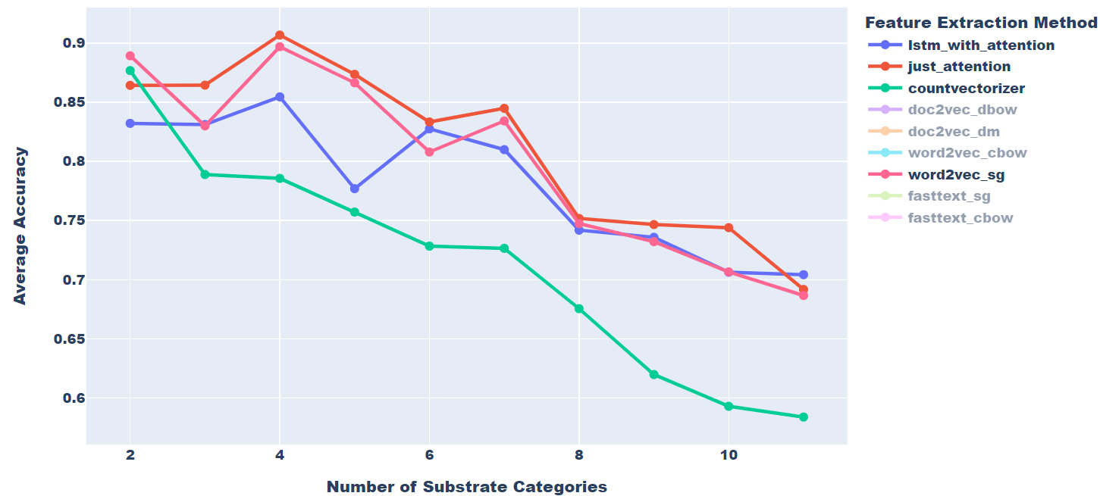
Results - Substrate Classification Models

Slide 15
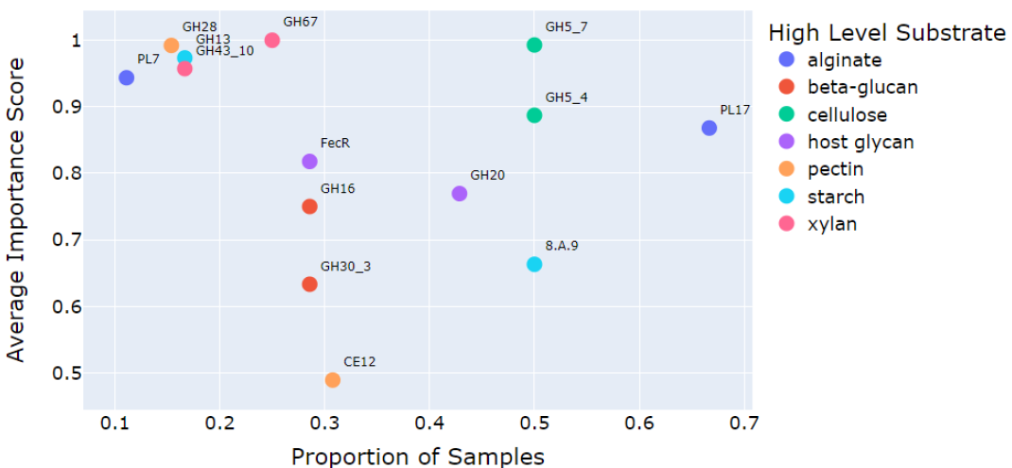
Results – Signature Genes using the Attention Module

Slide 16
Appendix

Slide 17
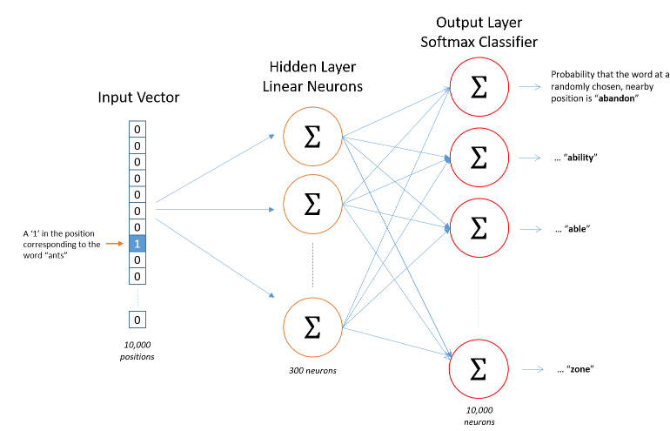
Gene Embedding Modules - Skip-Gram Word2Vector

Slide 18
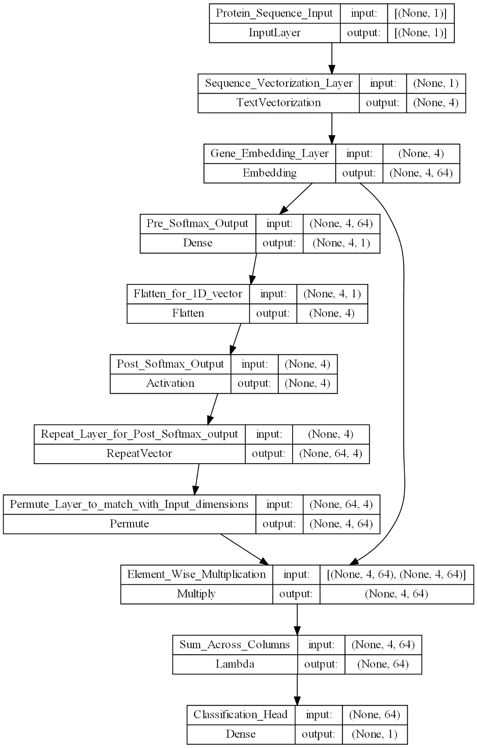
Customized Weight Learner – Model Architecture
We assume here that all protein sequences have four genes.
This model can also work with variable-length protein sequences.

Slide 19
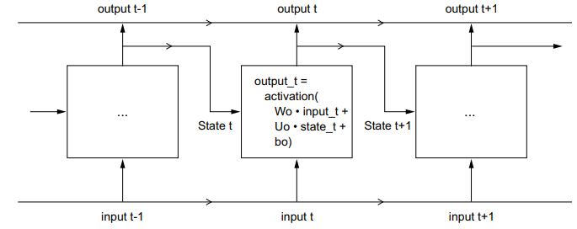
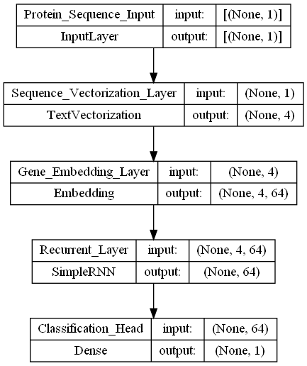
Recurrent Neural Network - Architecture
So, what is the recurrent layer?
The weights are learned using Back Propagation through time (BPTT).
Most of the learnable parameter's overhead is from the Gene Embedding Layer.
Since we have 348 genes this layer has 348 x 64 = 22,722 number of parameters.
We only have 411 training sequences, learning all 22,722 parameters will be difficult.
We therefore resort to transfer learning:
Instantiate the parameters in the Gene Embedding Layer using the embedding modules of Word2Vec.
Freeze this layer so that the backpropagation algorithm doesn’t change them.
Only tune the weights of the recurrent and the classification head layer.

Slide 20
Old - Results

Slide 21
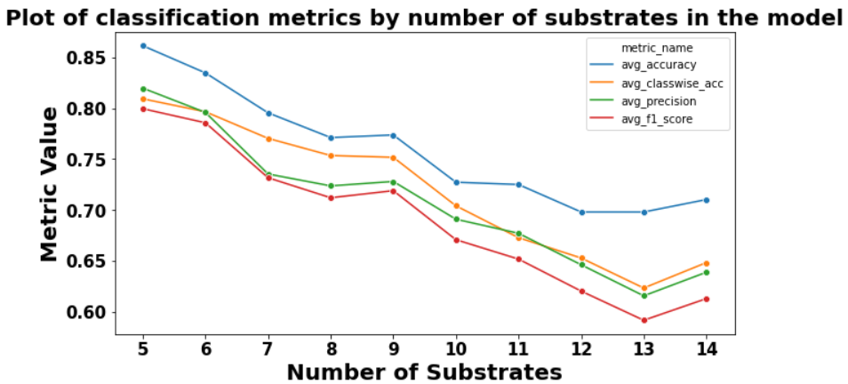
Results (with Others category)

Slide 22
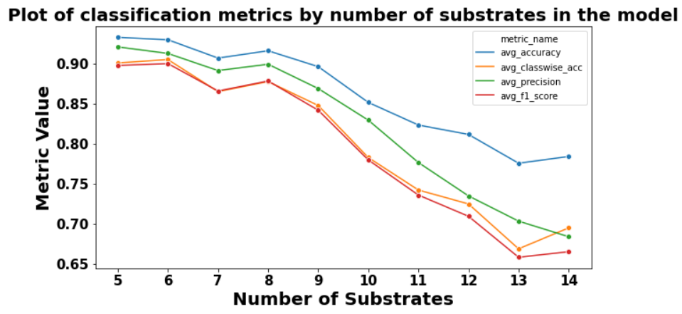
Results (without Others category)

Slide 23
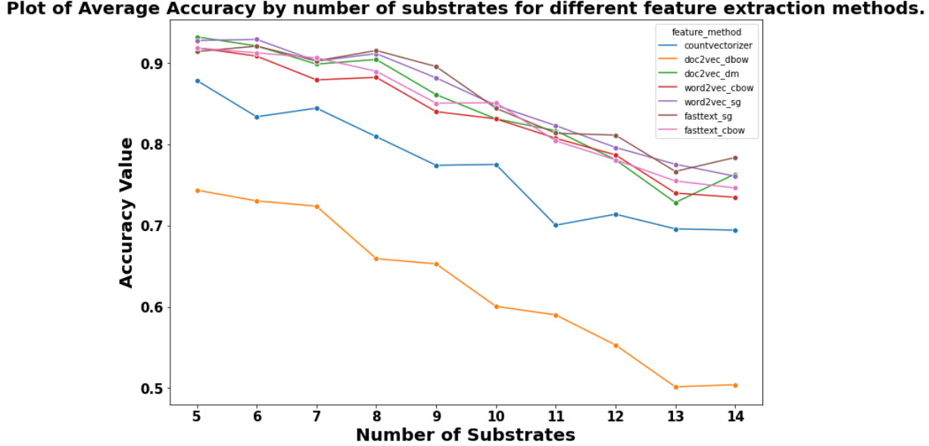
Results for different embedding modules

Slide 24
Results – Recurrent Deep learners

Slide 25
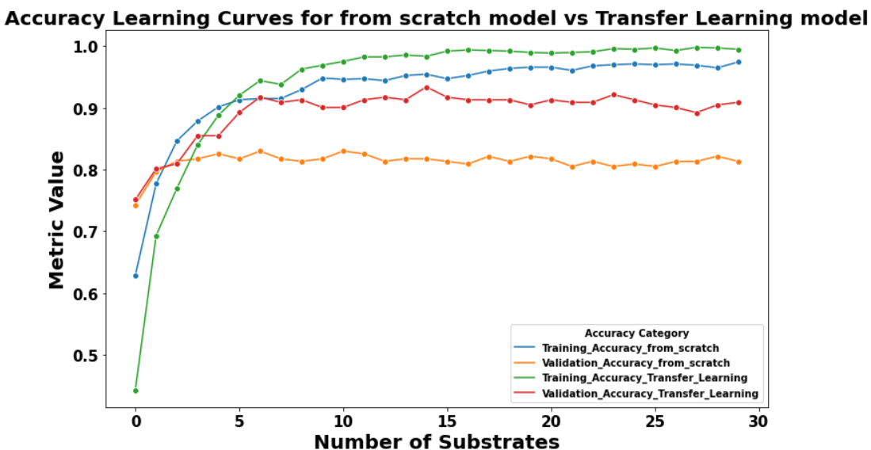
Results for Recurrent Neural Networks
Here we use the top 5 most frequent categories for the multiclass classification.

Slide 26
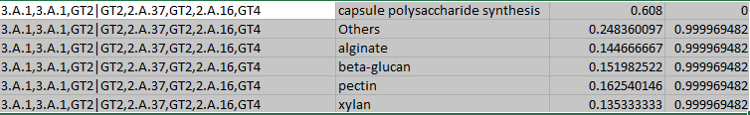
P value sample Output

Slide 27
Detecting out of distribution sequences

Slide 28
Out of Distribution - Problem
The number of protein categories are not fixed, many categories are yet to be discovered.
Many genes from the unsupervised protein sequences are not encountered in the training sequences.
Therefore, a method is needed which can detect out of distribution protein sequences:
So that we can tell that the sequences is a previously undetected sequence.
Not provide a (forced) prediction when we shouldn’t.
This sets up the stage to quantify the uncertainty in our predictions.
Two main methodologies:
Bayesian learning – Variational Inference + Monte Carlo Dropouts
Likelihood Ratios for Out of Distribution Detection

Slide 29
Bayesian Neural Network – Variational Inference
Two types of uncertainties in a supervised learning problem.
Uncertainty due to data – Aleatoric uncertainty
Uncertainty due to learned parameters – Epistemic uncertainty
Variational Inference provides a way to learn posterior weight distributions for the model parameters.
Actual posterior distribution difficult to fit due to intractable intergals.
Fit using MCMC methods.
Idea:
Start with 1 dimensional gaussian priors on all model weights.
Learn a posterior Multivariate Normal Distribution for the weight parameters.
Now the prediction for a test sequence is not deterministic.
Every time we predict, we will get a different Conditional Probability Distribution.
We can use this to calculate metrics such as Entropy, NLL, Total Variance (of all classes) to filter out uncertain predictions from the model.

Slide 30
Bayesian Learning – Monte Carlo Dropout
Variational Inference almost doubles the number of learnable parameters in the model.
Because we learn a mean and variance for each of the weights.
Monte Carlo Dropout is a regularization method in deep learning that has a Bayesian interpretation.
Idea:
During training, each weight parameter has a probability of p to be set to zero.
This is equivalent to a Bernoulli(p) prior on the weights.
In this method, we also turn on this behavior during testing time.
Doing this enables us to get probabilistic predictions for new test sequences.
Like VI in this method too we can get many different CPDs for a test sequence.
And then use metrics such as NLL, Entropy, Total Variance to filter out uncertain predictions

Slide 31
Methods – Feature Extractors

Slide 32
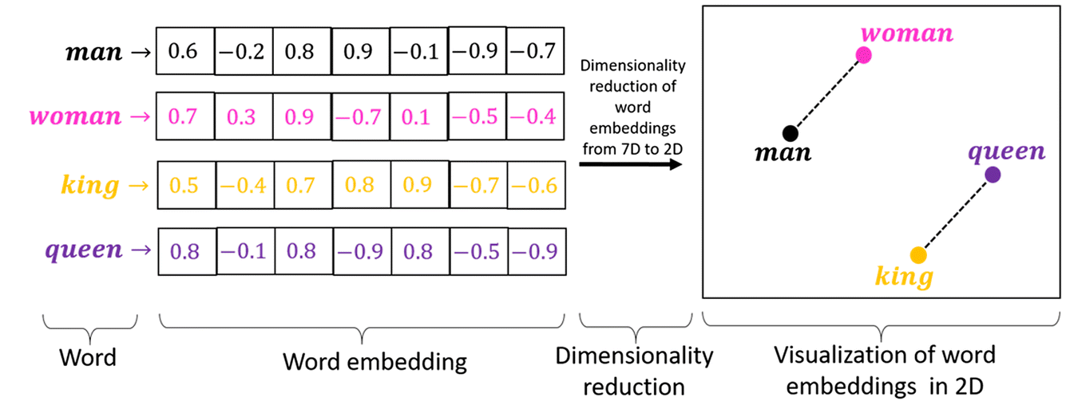
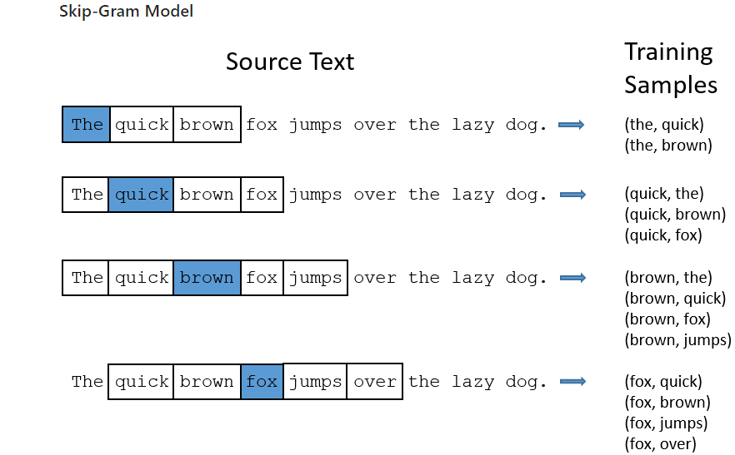
Feature Extractor– (Skip-Gram) Word2Vector

Slide 33
Machine Learning Methods

Slide 34
Classification Scheme
Creating a model for all 26 categories is not possible.
Two Options
Method: Create a model to predict the top k most frequent substrates.
Assumption: We will only see CGCs belonging to these top k substrates during the prediction stage.
Challenge: Figure out a way to detect training distribution samples.
Method: Create a model to predict the top k most frequent substrates + an Others category.
Assumption: Others comprise only the not top k substrates defined apriori.
Challenge:
Handle the heterogeneity in the CGC samples of the Others category.
Figure out a way to detect training distribution samples.

Slide 35
Baseline
Input features are created by count vectorizing the protein sequences. (Bag of Words: BOW)
Model: One vs Rest Classifier (with a Balanced Random Forest [BRF]) – (mainly to get p values)
BRF balances the number of samples per class in each bootstrapped sample.
Data is quite unbalanced. Balancing helps reduce the majority class bias of the model.
We use a nested 10 x 5 nested cross-validation scheme.
Inner loop is used to select the best hyper-parameters.
Outside loop then uses the selected hyper-parameters for estimating model performance.

Slide 36
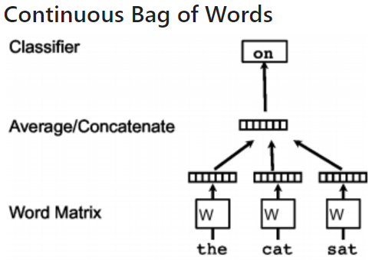
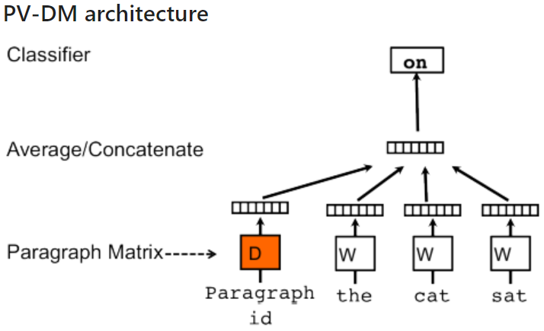
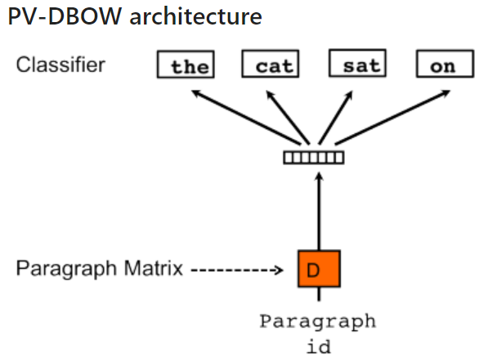
Feature Extractors– Word2Vec CBOW & Doc2Vec architectures
Paragraph ID 1: The cat sat on the mat
Doc2Vec architectures

Slide 37
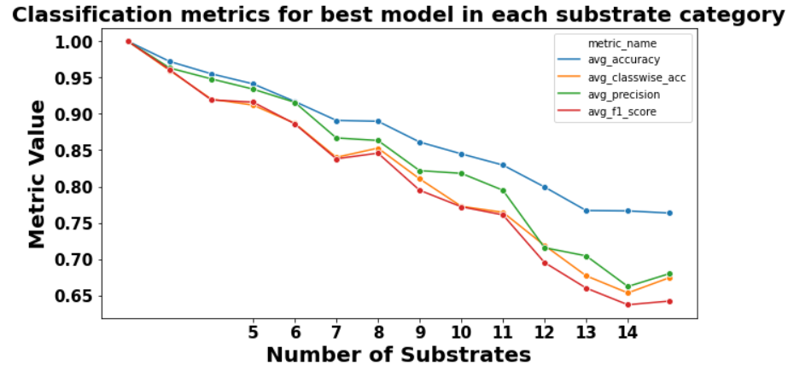
Results (without Others category) – Classification Metrics

Slide 38
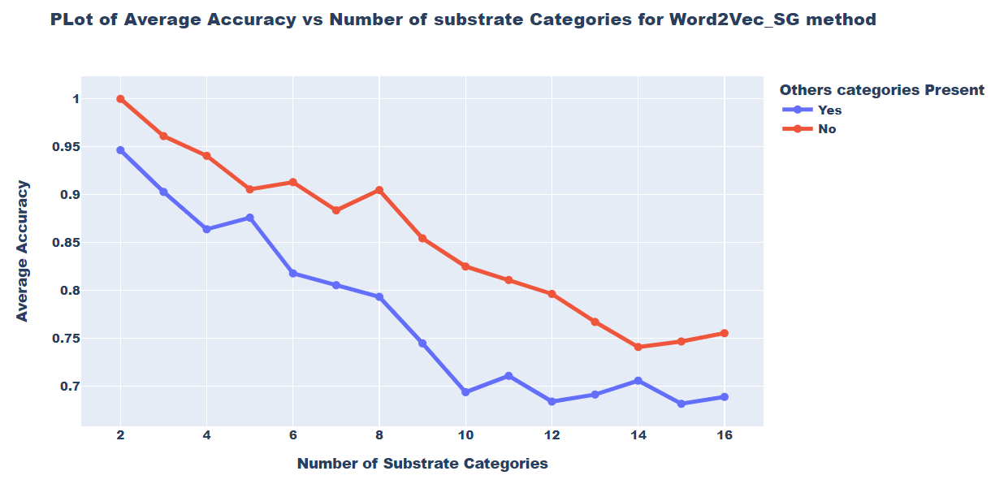
Results (with and without Others category) – Word2Vec Skip-Gram

Slide 39
Recommendations
Use an attentive deep learning model – balanced performance with interpretability.
Use the setup which only uses top k most frequent substrates without the Others category.
Only provide predicted substrates for such CGCs which:
The CAZyme from the literature is the most important gene using the attentive model.
The predicted probability score is above a high threshold value (for example – 80%).
We can envision a weighted two-step filtering process using the above two criterias.

Slide 40
Progress till date & Next Steps
We now can:
Prepare CSV files from any unsupervised CGC data dump.
Create Word2Vec, Doc2Vec, and FastText feature extractors (highly parallelized version for speed of training).
Train and evaluate the k-fold cross-validated performance of shallow and deep learners.
Script demonstrating the implementation of sub finder pipeline for UHGG data:
Output: predicted substrate, predicted probability score, p-value
Next Steps:
Implement the domain-expert filtering condition.
Run experiments to assess the filtering conditions’ impact on the Precision of the model.
Decide the kind of interpretation to provide with the predicted substrate.

Slide 41
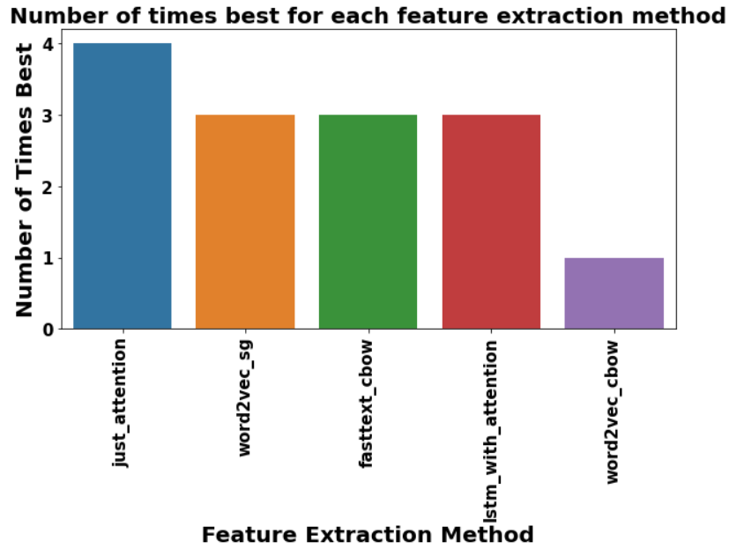
Assessing the Feature Extraction Methods (without Others category)

